Slide 1



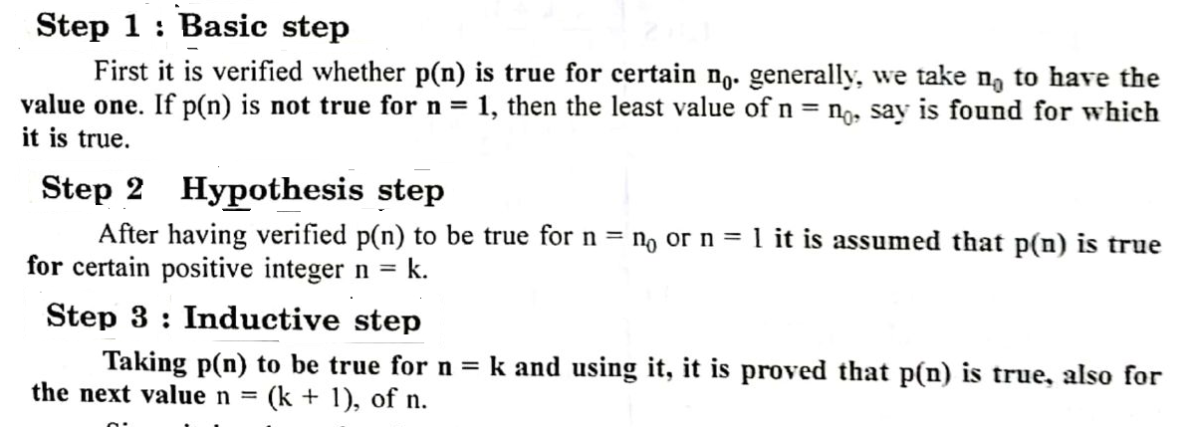
Principle of Mathematical Induction

Slide 2
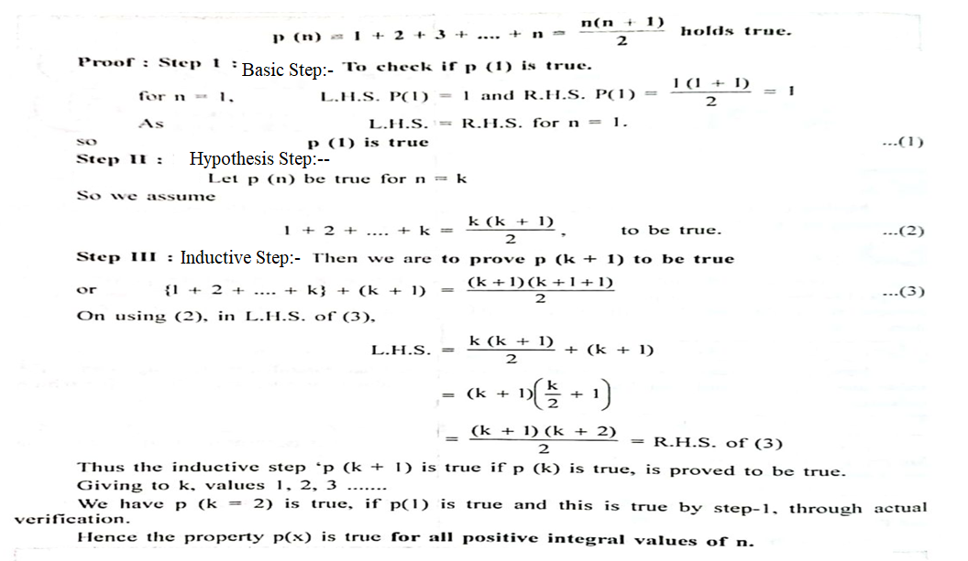
Q-1: Prove by the principle of Mathematical Induction that for all positive integers n ≥ 1

Slide 3


Q-2: Prove by the principle of Mathematical Induction that for

Slide 4
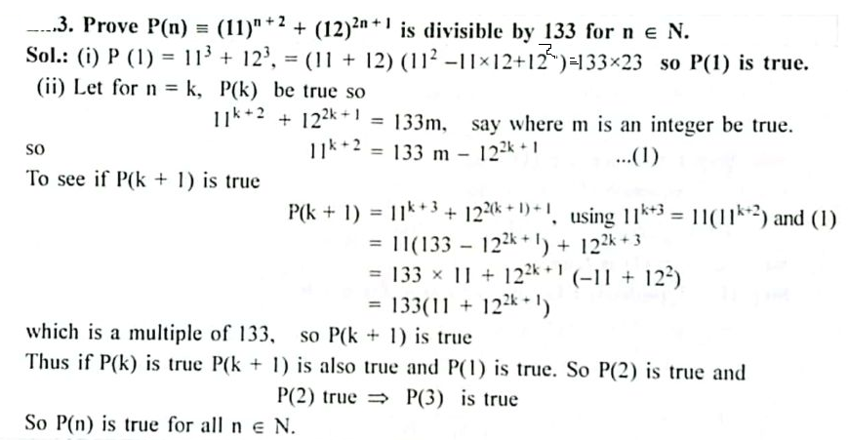
Q-

Slide 5
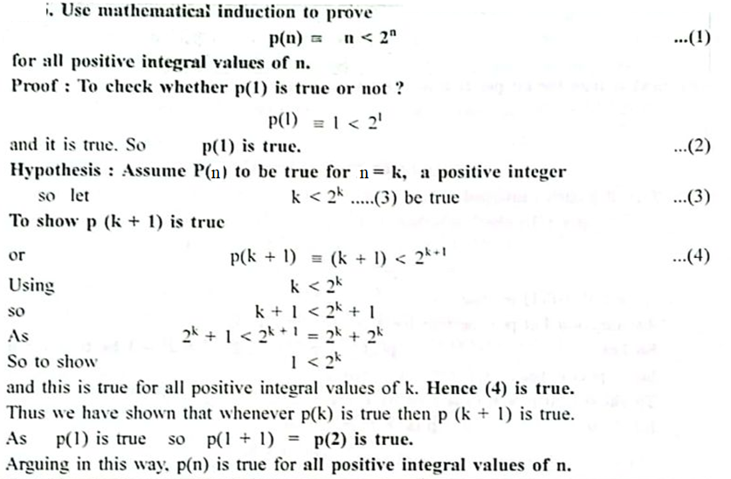
Q- 4

Slide 6
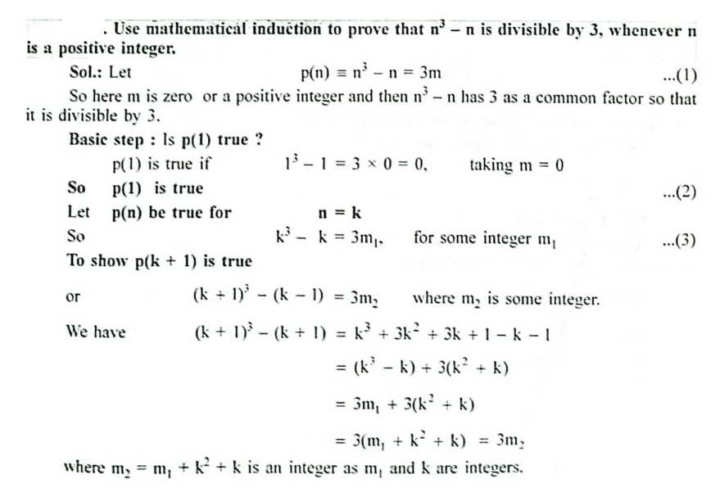

Q- 5
…(4)

Slide 7

Principle of Complete Induction

Slide 8
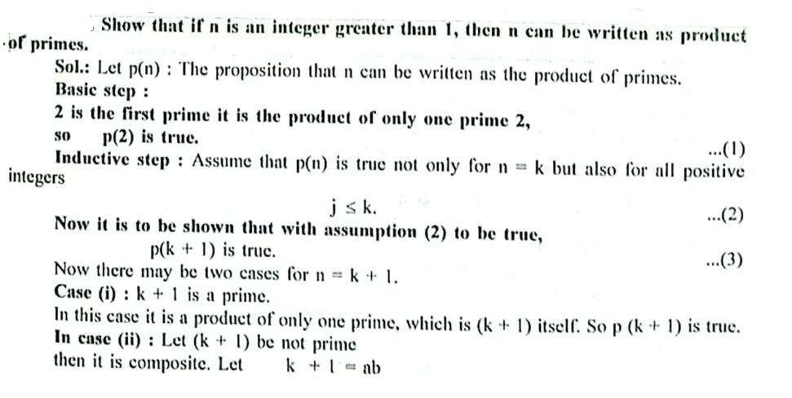
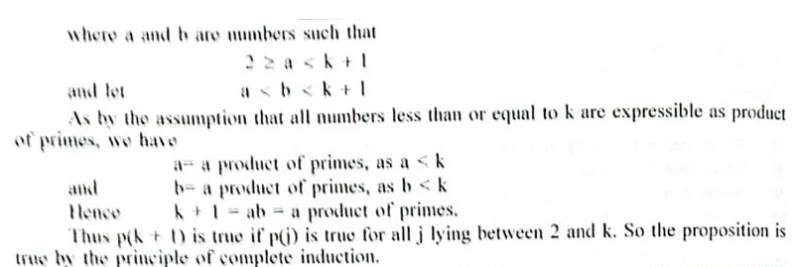
Q- 1

Slide 9
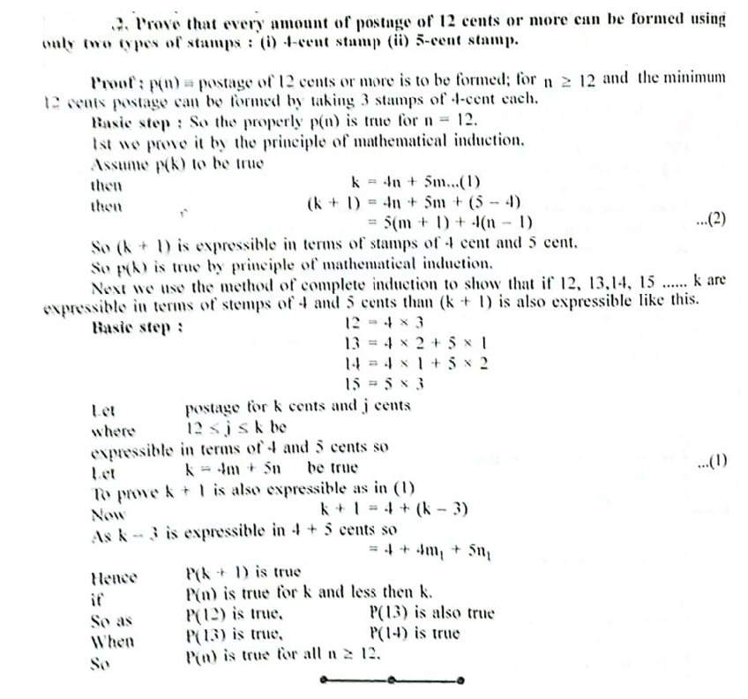
Q- 2

